Slide 1

How to Create the Perfect Case Study

Slide 2
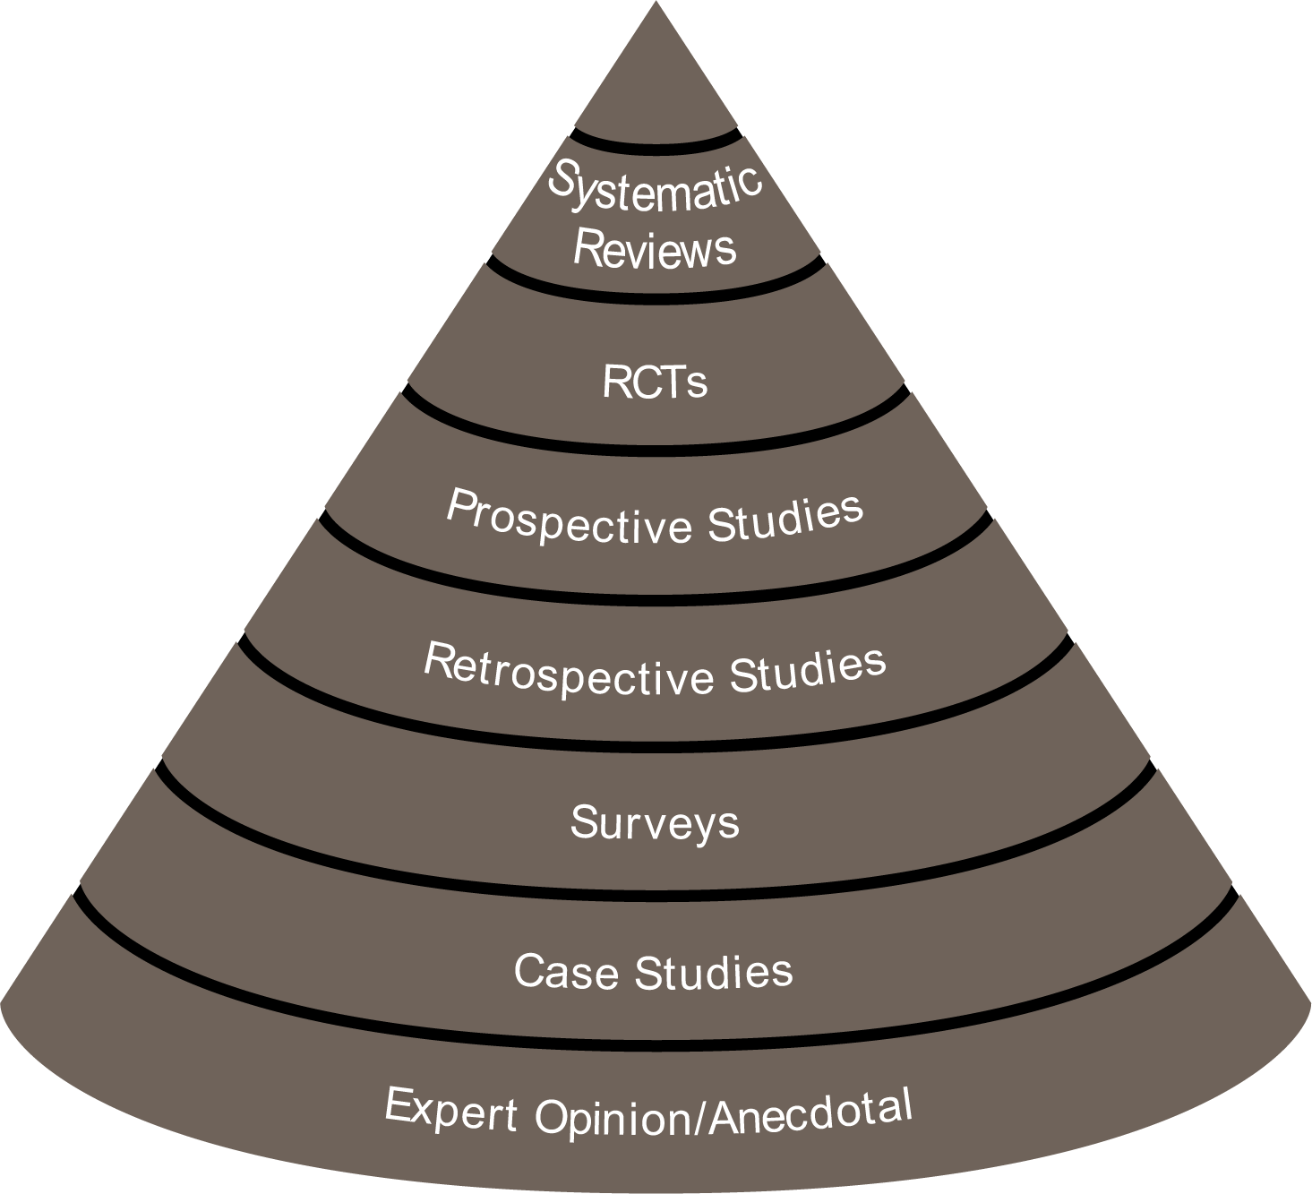
Clinical Evidence Hierarchy
2nd Tier
Notes:
Case studies are ranked on tier 2 on the clinical evidence hierarchy. However, just because they have such a low rank does not mean that they should be ignored. Case studies are a fantastic opportunity to engage with customers on a very clinical level and gain valuable insights into their everyday challenges and successes.

Slide 3
Case Studies
Strengths
Limitations
Easy to collect
Documents a patient outcome
Pictures say a thousand words
First step in building evidence
Is a “cherry picked” outcome
No control comparison
May not be representative of typical experience
Notes:
Most of our customers will be familiar with case studies. They show the clinical effect of a particular intervention, which is usually the result of an interesting experience or rare outcome.
Case studies typically focus on a single patient or a series of cases with similar outcomes and are the first stepping stone in building evidence.
This level of evidence has the following strengths. they are easy to collect, they document the patient’s outcome, and usually have pictures, which say a thousand words, they are the first step in building evidence.
The limitations are that there is a “cherry picked” outcome, there usually is no control comparison, and the results may not be representative of the typical experience so it is not generalizable.

Slide 4
What tools do we have to help create the perfect case study?

Slide 5
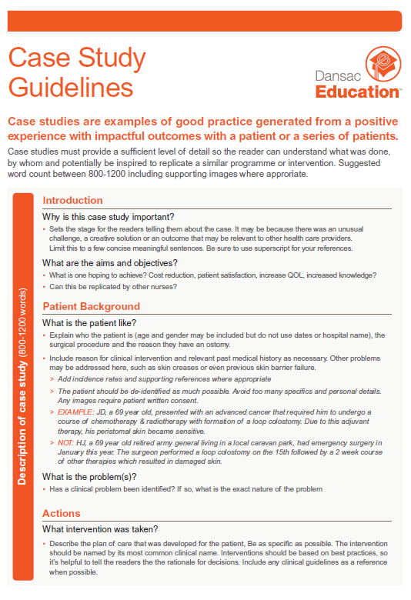
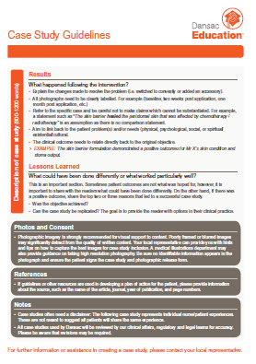
Case Study Guidelines
Notes:
The document aims to guide the clinician through the case study process. It asks the clinician leading questions, why is this case study important, what am I hoping to achieve, will this case study help my fellow colleagues in their practice and more importantly will this drive positive clinical outcomes for our patients.
It also provides some brief information regarding photo’s and consent, references and the need to add any disclaimers

Slide 6
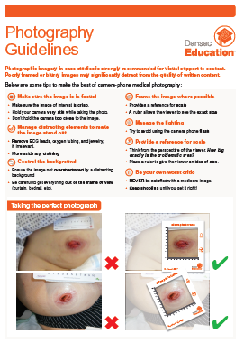
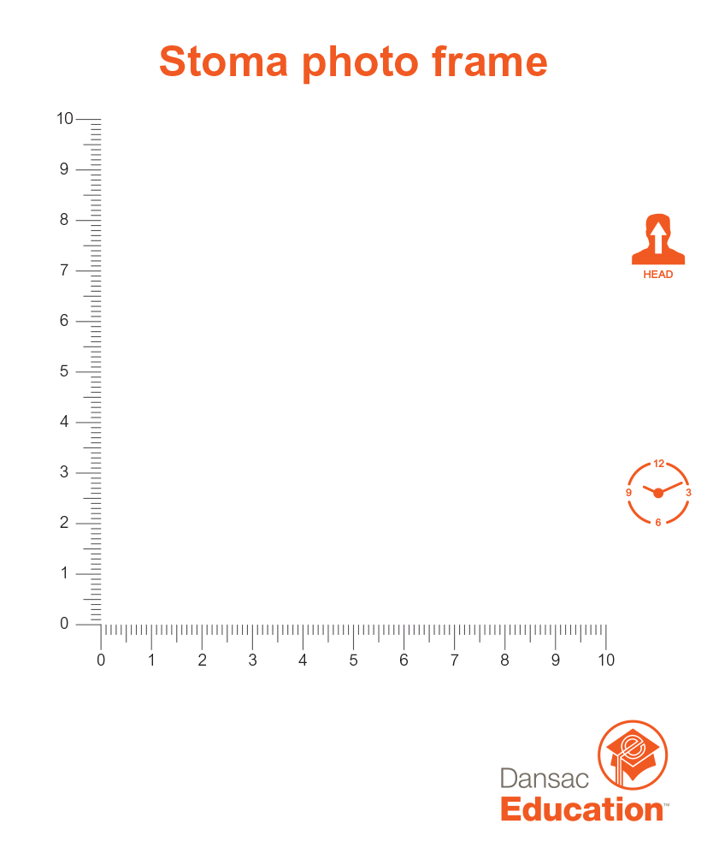
Photography Guidelines
Notes:
Most case study's use photographic imagery as visual support to content. Poorly framed or blurry images may significantly detract from the quality of written content.
The hints and tips included on this document are very simple and the stoma photo frame is a fantastic tool/giveaway for our customers to help support and capture the perfect photo. Some persitomal skin conditions may be so severe to extend outside the frame and use of this tool will be left at the nurses discretion.

Slide 7
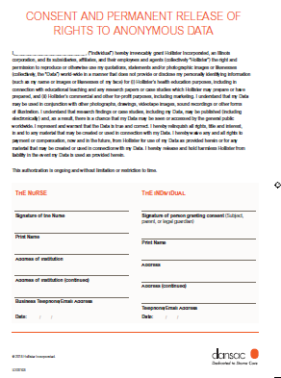
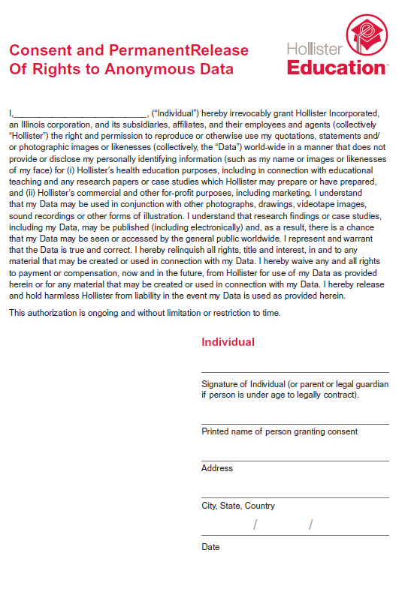
Consent Release Form
Notes:
For any clinician to share a case study with our organisation we would require the consent agreement and permanent release of rights to be completed. There is a section for both the nurse and the patient to sign. On the very rare occasion a patient may wish to share their own story and we have a separate form which can be used and do contact .

Slide 8
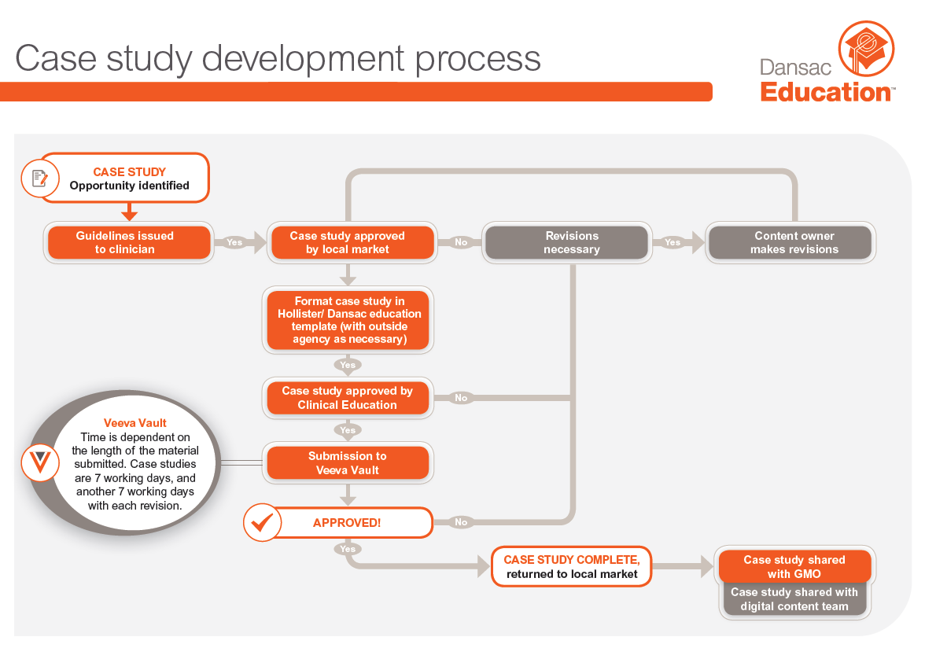
©2018 Hollister Incorporated.
Notes:
It is important to understand the process of case study development.
Case study opportunity identified by the local market and guidelines are issued to the clinician
Case study is approved by the local market and formatted in the Hollister Dansac education template.
Case study is approved by clinical education and the local market submits to veeva vault.
Time through the VV system is dependant of the length of the material. Case studies are 7 working days and each subsequent revision will take another 7 days.
If revisions are required this is returned to the local market and the process begins again.
If the case study is reviewed, this is returned to the local market and the case study shared with GMO and the digital content team

